Slide 1
What We Will Learn
Introduction
Filesystem Hierarchy Standard
Directory layout of Linux FS
Help
Mounting

Slide 2
Introduction
Filesystem
  How are data stored in storage?
  How do users access the data?
    Data organization, files and directories
Filesystem types
  Disk FS: ext2, ext3, FAT, FAT32 & NTFS
  Network FS: Samba & NFS
  Flash FS: JFFS2
  Special FS: proc FS

Slide 3
Introduction (cont’d)
You should understand Linux FS
  Why?
Everything in Linux is file, if it is NOT process
  Easy to use
    Open file, read/write and close the file
Unlike Windows, Linux FS is standard FS
  Everyone should learn standards

Slide 4
Filesystem Hierarchy Standard
Started by Dennis Ritchie, 1993
Defines the main directories and their contents in most Linux-based systems
Current Version: 2.3, 29 Jan 2004.

Slide 5
FHS
There is not any drive C:, D:, …
All directories are under “/”
  “/” is the root directory
It is possible
  to have multiple partitions
  to multiple filesystems

Slide 6
The “/”
The primary hierarchy in FSH
  The root of tree of filesystem
All paths start form here
There is only one “/” in filesystem

Slide 7
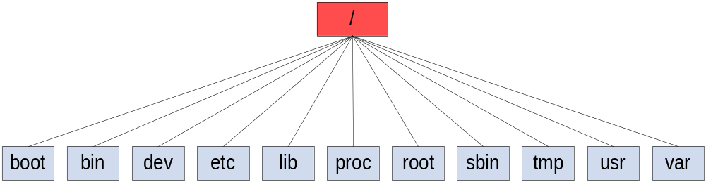
The “/”

Slide 8
boot
Linux kernel
Boot loader configuration
If you lost boot
  You cannot boot your OS

Slide 9
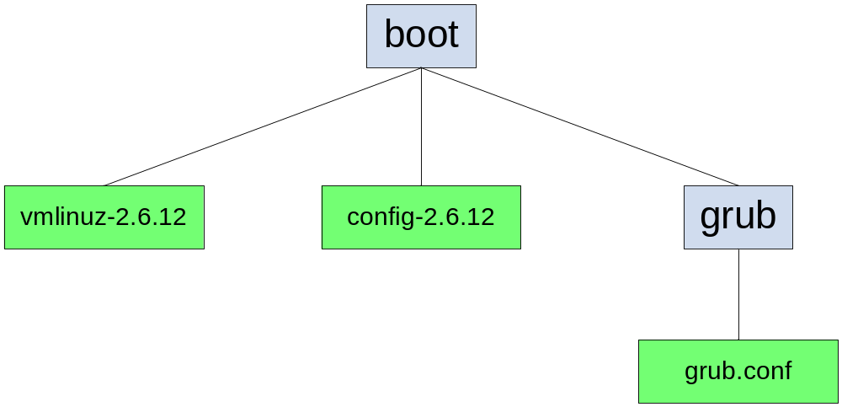
boot

Slide 10
bin
Essential programs
Need for system startup
Basic commands for
  Navigating in filesystem
  File management

Slide 11
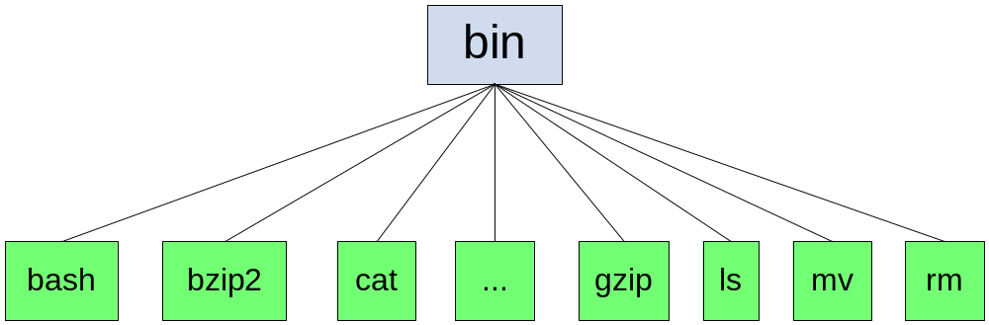
bin

Slide 12
dev
Everything is file
  Hardware components (devices) are file
    Hard disk
    Key board
All device files are here
Direct interaction with device driver
  Open the device file
  Read & Write

Slide 13
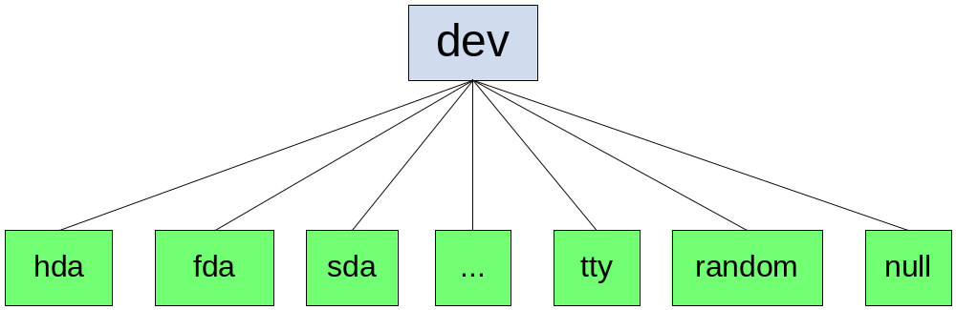
dev

Slide 14
etc
System configuration directory
  What is done by the registry in Windows
All configuration file are text files
  You can view and edit it manually

Slide 15
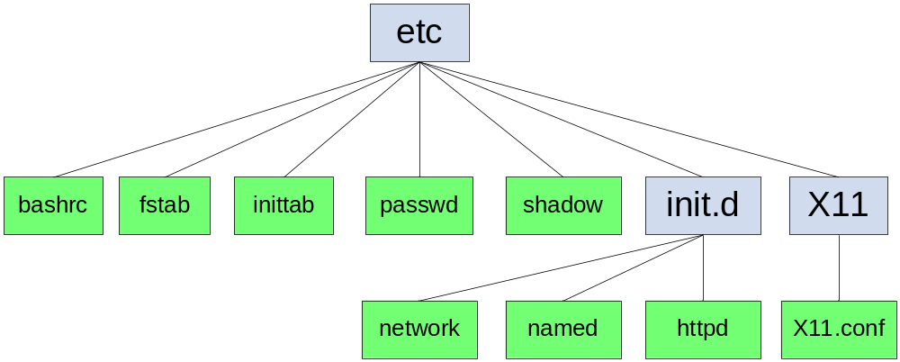
etc

Slide 16
home
Home directory of user
Each user has a directory
  /home/bahador
  /home/hamed
All files of user are stored here

Slide 17
lib
Programs need libraries
  Dynamically linked libraries
Programmers need libraries
All essential libraries are here
  Needed for system startup

Slide 18
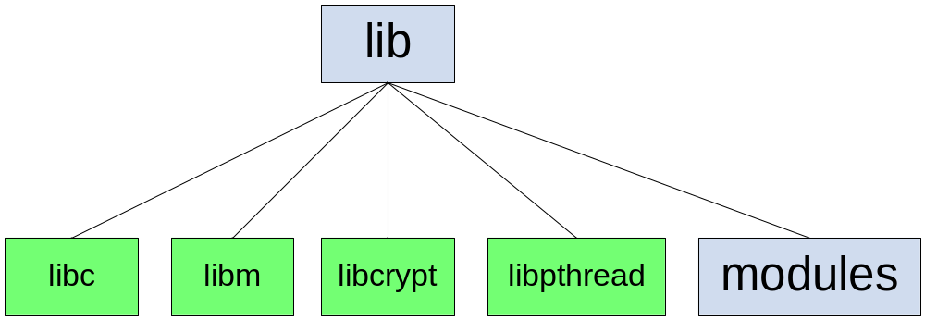
lib

Slide 19
proc
Kernel’s interface
  Kernel pseudo-directory
Special directory
  It is NOT a directory on hard disk
Kernel Configuration
Kernel State monitoring

Slide 20
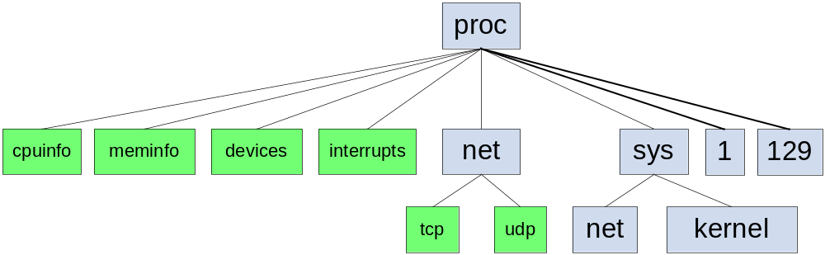
proc

Slide 21
root
Home directory of root
Don’t confuse
  / is the “root of Filesystem”
  root is the name of system admin
  /root is the admin

Slide 22
sbin
System configuration programs
  Format hard disk
  Manage hardware
Only “root” can run the programs

Slide 23
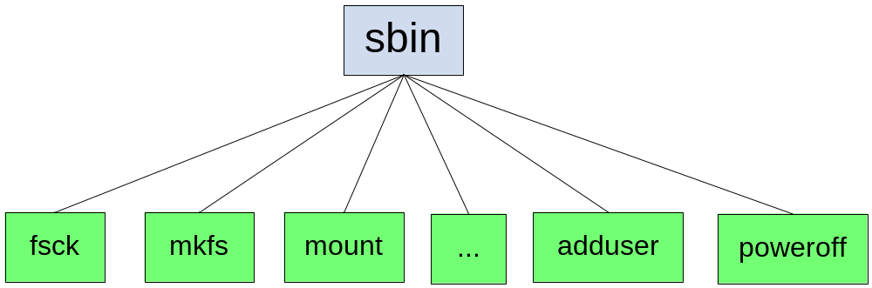
sbin

Slide 24
tmp
Temporary directory
All temp files are created by programs
Your temp files
It is emptied regularly

Slide 25
usr
Secondary hierarchy
Very useful programs
  We usually use them
    compiler, tools
Are not essential for system startup

Slide 26
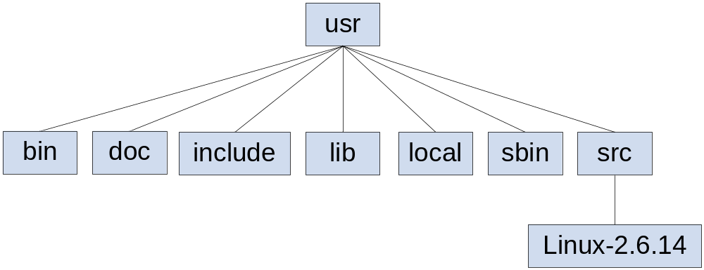
usr

Slide 27
var
The variable directory
All dynamic files
User cannot change the files

Slide 28
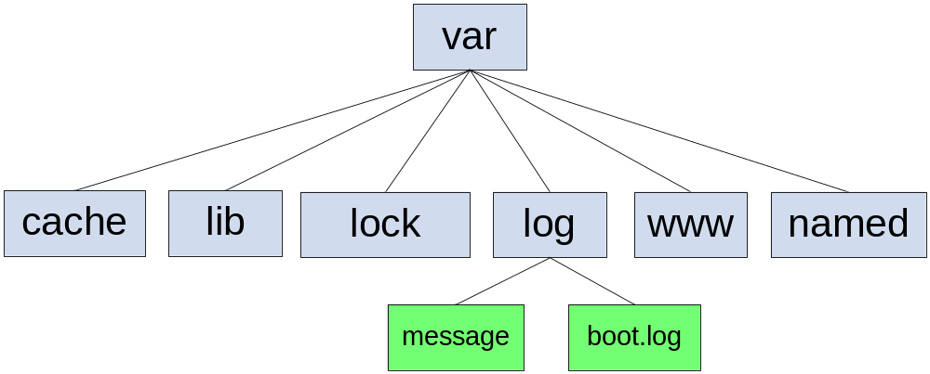
var

Slide 29
Helps
Some documents are in /usr/share/doc
Info pages are not complete help
  info <command name>
Man pages
  /usr/share/man
  man1: user commands, man8: System administration
  man <command name>

Slide 30
Permissions
There are 3 basic permissions
  Read (r)
  Write (w)
  Execute (x)
How to find them
  ls -l
How to change them
  chmod +/- r/w/x <filename>

Slide 31
Mounting
Mount
  To add a filesystem to other filesystem
    Add you cool-disk FS to you laptop FS
How?
  mount <options> <device> <mount point>
  mount -t vfat /dev/sdb1 /mnt/flash
Don’t forget the umount
  umount <mount point>
  umount /mnt/flash

Slide 32
Linux FS vs. Windows FS
There is not drive C:, D:
Top hierarchy is /
Path separator is / not \
File extensions have NOT any meaning
There is not hidden attribute, hidden files are started by .

Slide 33



